Slide 1
Knowing the Data

Slide 2
What to Know about the Data?
What are the types of attributes or fields that make up the data?
Which attributes are discrete, and which are continuous‐ valued?
How are the values distributed?
Are there ways we can visualize the data to get a better sense of it all?
Can we spot any outliers?
Can we measure the similarity of some data objects with respect to others?

Slide 3



















Types of Data Sets
Record
Relational records
Document data: text documents: term‐frequency vector
Transaction data
TID | Items
1 | Bread, Coke, Milk
2 | Beer, Bread
3 | Beer, Coke, Diaper, Milk
4 | Beer, Bread, Diaper, Milk
5 | Coke, Diaper, Milk

Slide 4
Data Objects
Data sets are made up of data objects
A data object represents an entity
Examples:
sales database: customers, store items, sales
medical database: patients, treatments
university database: students, professors, courses
Also called samples, examples, instances, data points, objects, tuples
Data objects are described by attributes
Rows ‐> data objects
Columns ‐>attributes

Slide 5
Attributes
Attribute (dimensions, features, variables)
data field representing a characteristic or feature of a data object
E.g., customer _ID, name, address
Types:
Nominal
Binary
Numeric: quantitative
Interval‐scaled
Ratio‐scaled

Slide 6
Attribute Types
Nominal/Categorical: categories, states, or “names of things”
Hair_color = {black, blond, brown, grey, red, white}
marital status, occupation, ID numbers, zip codes
Binary: nominal attribute with only 2 states (0 and 1)
Symmetric binary: both outcomes equally important
e.g. gender
Asymmetric binary: outcomes not equally important
e.g. medical test (positive vs. negative)
Convention: assign 1 to most important outcome (e.g. HIV positive)
Ordinal: Values have a meaningful order (ranking) but magnitude between successive values is not known
Size = {small, medium, large}, grades, army rankings

Slide 7
Attribute Types
Numeric (integer or real‐valued)
Interval
Measured on a scale of equal‐sized units
Values have order
E.g., temperature in C˚or F˚, calendar dates
No true zero‐point
Ratio
Inherent zero‐point
We can speak of values as being an order of magnitude larger than the unit of measurement (10 K˚ is twice as high as 5 K˚).
e.g., temperature in Kelvin, length, counts, monetary quantities

Slide 8
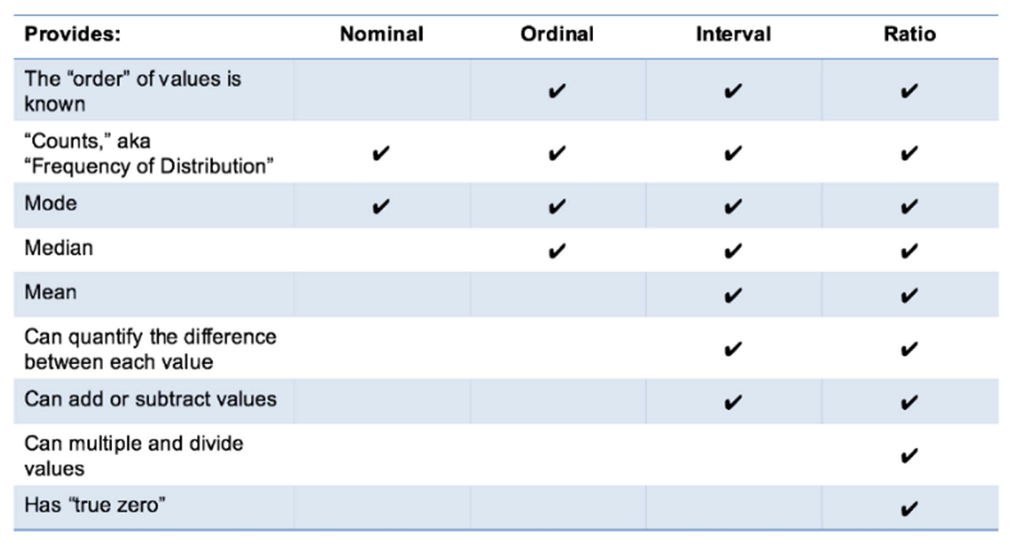
Attribute Types

Slide 9
Discrete vs. Continuous Attributes
Discrete Attribute
Has only a finite or countably infinite set of values
E.g. zip codes, profession, or the set of words in a collection of documents
Sometimes represented as integer variables
Continuous Attribute
Has real numbers as attribute values
E.g. temperature, height, or weight
Practically, real values can only be measured and represented using a finite number of digits
Typically represented as floating‐point variables

Slide 10
Basic Statistical Descriptions of Data
To better understand the data: central tendency, variation and spread
Data dispersion characteristics
– median, max, min, quantiles, outliers, variance, etc.

Slide 11
Types of Measures
Distributive measure
computed by partitioning the data into smaller subsets
Algebraic measure
computed by applying an algebraic function to one or more distributive measures
Holistic measure
computed on the entire data set as a whole
much more expensive to compute than distributive measures

Slide 12
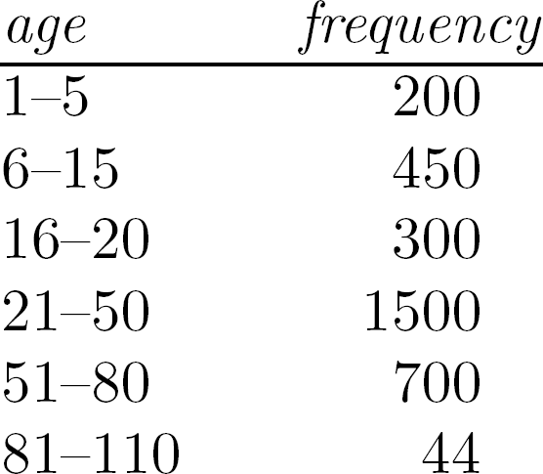
Measuring the Central Tendency
Mean:
– Weighted arithmetic mean
x = ¹ ∑ x μ = ^{∑ x}
n
n
i
N
i =1
n
– Trimmed mean: chopping extreme values
∑ ^{w}i ^{x}i
i =1
∑ ^{w}i i =1
x =
n
Median:
– Middle value if odd number of values, otherwise average of the middle two values
n / 2 − (
∑
freq)
median = L + (
l
)width
Median interval
1
freq
median

Slide 13
Measuring the Central Tendency
Mode:
Value that occurs most frequently in the data
Unimodal, bimodal, trimodal
Empirical formula:
mean − mode = 3× (mean − median)

Slide 14

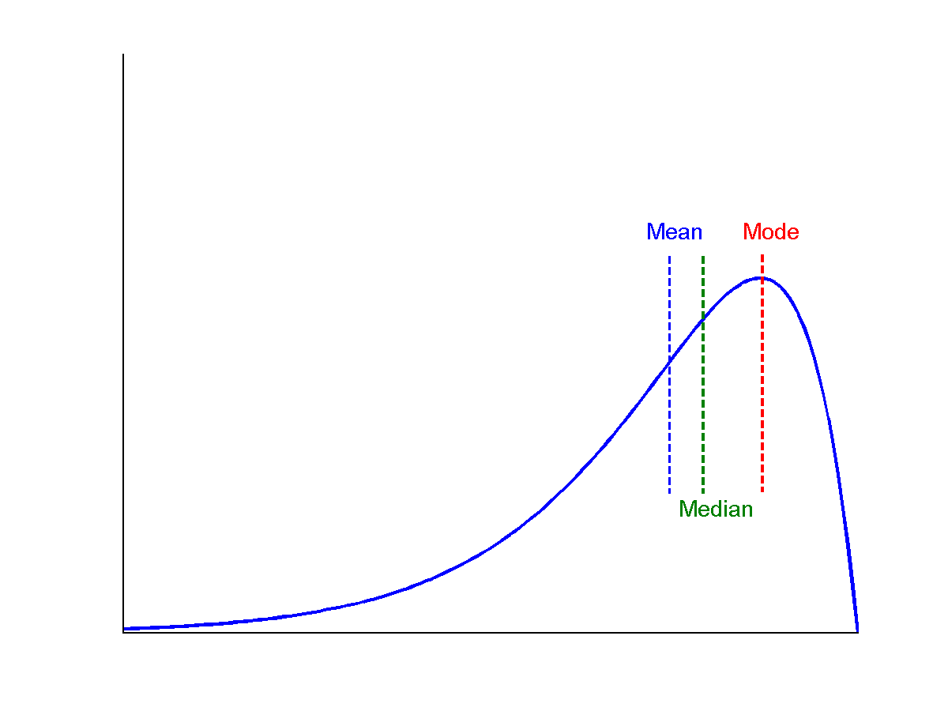
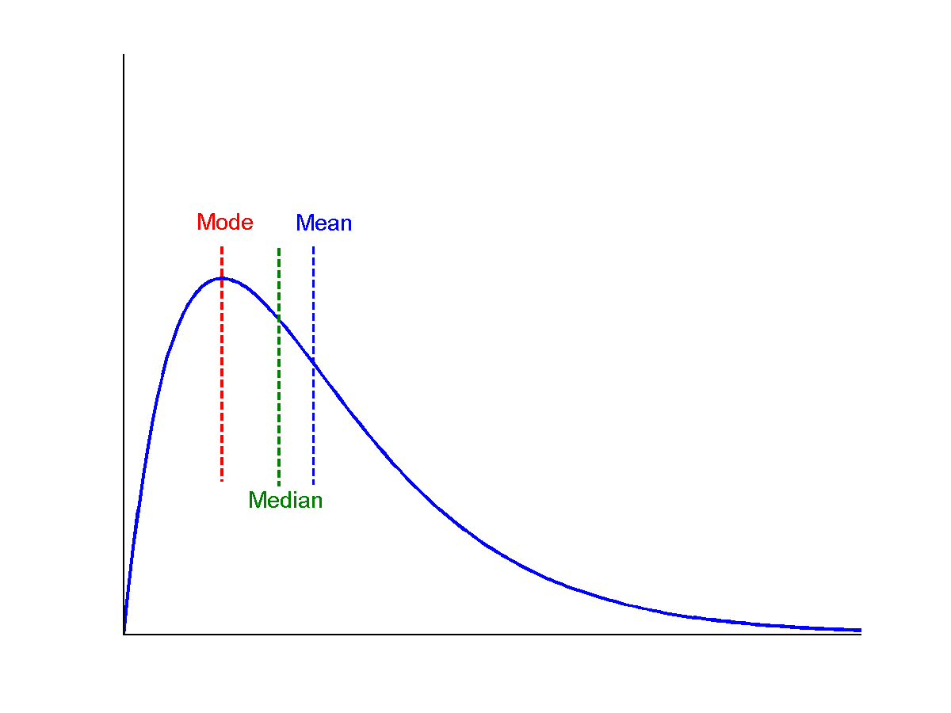
Symmetric vs. Skewed
Mean Median
symmetric
Mode
positively skewed
negatively skewed

Slide 15
Measuring the Dispersion of Data
Quartiles, outliers and boxplots
Quartiles: Q₁ (25th percentile), Q₃ (75th percentile)
Inter‐quartile range: IQR = Q₃ – Q₁
Five number summary: min, Q₁, median, Q₃, max
Boxplot: ends of the box are the quartiles; median is marked; add whiskers, and plot outliers individually
Outlier: a value higher/lower than 1.5 x IQR
Variance and standard deviation (sample: s, population: σ)
Variance: (algebraic, scalable computation)
Standard deviation σ: is the square root of variance σ²
n
₌ 1 ∑
n
₌ 1 ∑
_{σ} 2
( x − μ ) ²
_{x} 2
− μ ²
N
i
N
i
i =1
i =1

Slide 16
Properties of Normal Distribution Curve
Normal (distribution) curve
From μ–σ to μ+σ: contains about 68% of the measurements (μ: mean, σ: standard deviation)
From μ–2σ to μ+2σ: contains about 95% of it
From μ–3σ to μ+3σ: contains about 99.7% of it
68%
95%
99.7%
−3 −2 −1
0
+1 +2 +3
−3 −2 −1
0
+1 +2 +3
−3 −2 −1
0
+1 +2 +3

Slide 17
Graphic Displays of Basic Statistical Descriptions
Boxplot
Histogram
Quantile plot
Quantile‐quantile (q‐q) plot
Scatter plot

Slide 18
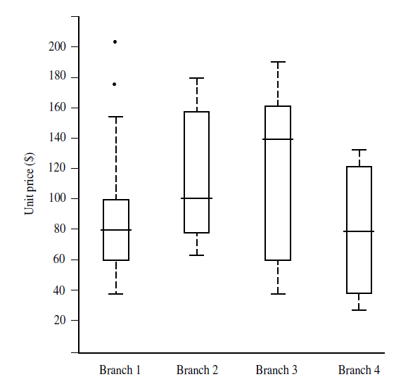
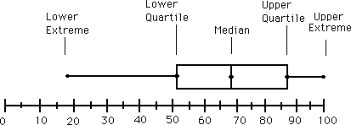
Boxplot Analysis
Five‐number summary of a distribution
– Minimum, Q1, Median, Q3, Maximum

Slide 19
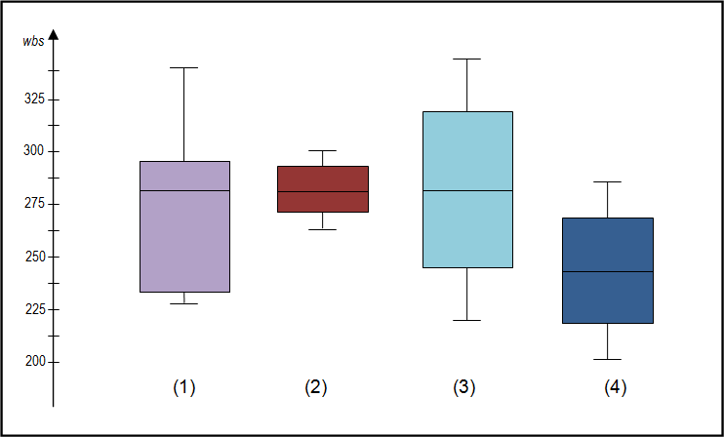
Boxplot Analysis
Box plots show overall patterns of response for a group. Visualise the range and other characteristics of responses for a large group.
Box plot is comparatively short – (2). Overall students have a high level of agreement with each other.
Box plot is comparatively tall – (1) and (3). Students hold quite different opinions about this aspect or sub-aspect.
Four sections of box plot are uneven in size – (1). Many students have similar views at certain parts of the scale, but in other parts of the scale students are more variable in their views. Long upper whisker implies students' views are varied amongst the most positive quartile group, and very similar for the least positive quartile group.
One box plot is much higher or lower than another – compare (3) and (4) – Suggests a difference between groups.
Same median, different distribution – (1), (2), and (3). Medians are all at the same level. However, box plots show very different distributions of views.

Slide 20
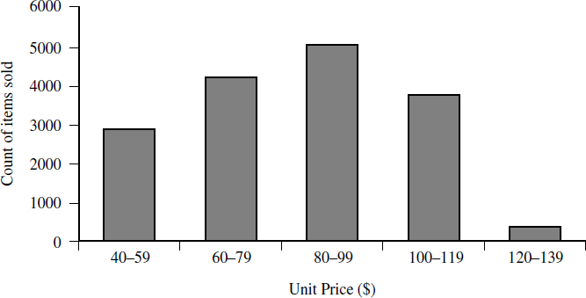
Histogram Analysis
Graphical display of tabulated frequencies, shown as bars
Shows what proportion of cases fall into each of several categories
Differs from bar chart
Bar chart -> categoric variable, Histogram -> numeric variable

Slide 21
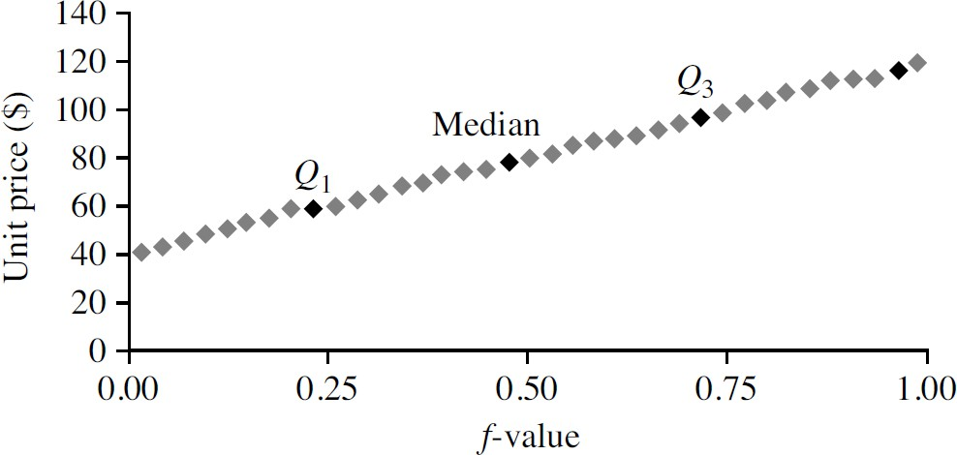
Quantile Plot
Displays all of the data for a given attribute
Assess overall behavior and unusual occurrences
Plots quantile information
Data x_{i} ’s are sorted in increasing order, (x_{i}, f_{i} ) are plotted, f_{i} indicates approximately 100 f_{i}% of the data are below or equal to the value x_{i}

Slide 22
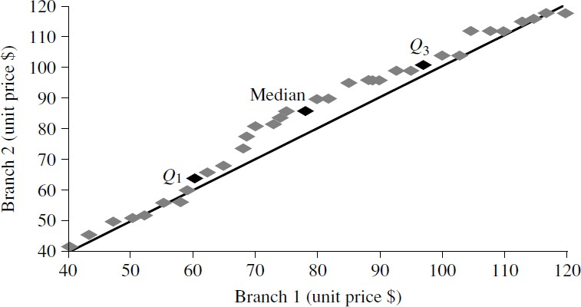
Quantile-Quantile (Q-Q) Plot
Graphs the quantiles of one univariate distribution against the corresponding quantiles of another
Objective: Is there is a shift in going from one distribution to another?
Example shows unit price of items sold at Branch 1 vs. Branch 2 for each quantile. Unit prices of items sold at Branch 1 tend to be lower than those at Branch 2.

Slide 23
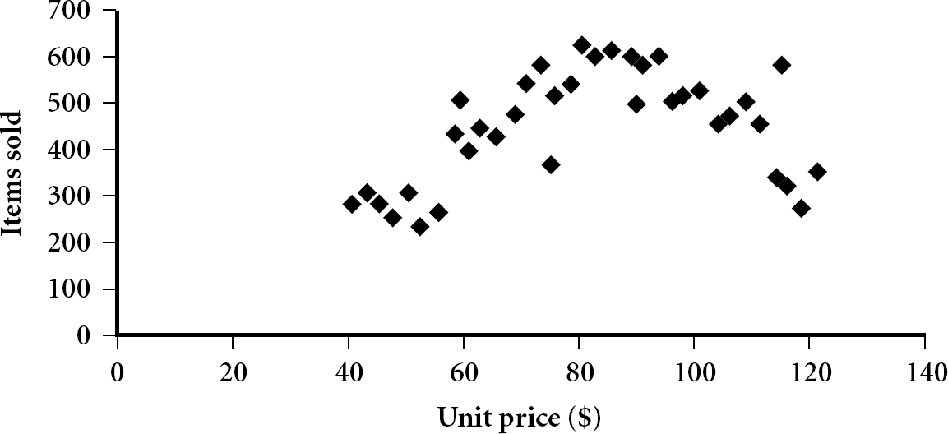
Scatter plot
Graphical methods to determine if there appears to be a relationship, pattern, or trend between two numerical attributes
Each pair of values is treated as a pair of coordinates and plotted as points in the plane

Slide 24
Positively and Negatively Correlated Data
The left half fragment is positively correlated
The right half is negatively correlated

Slide 25
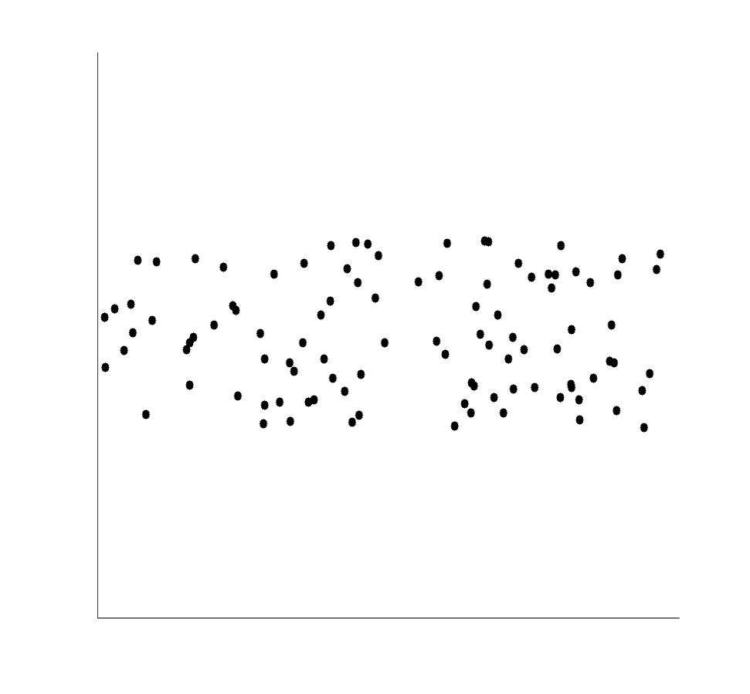
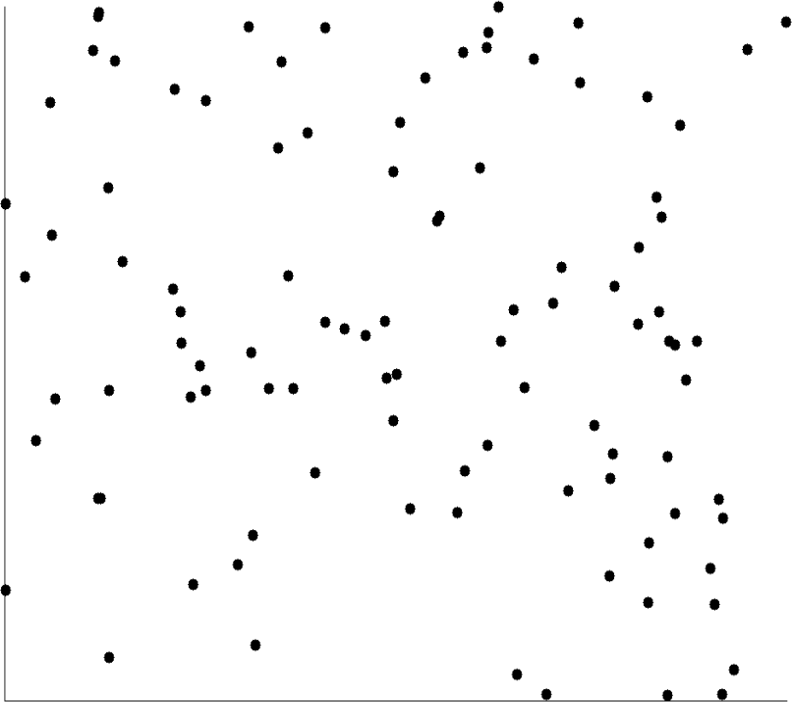
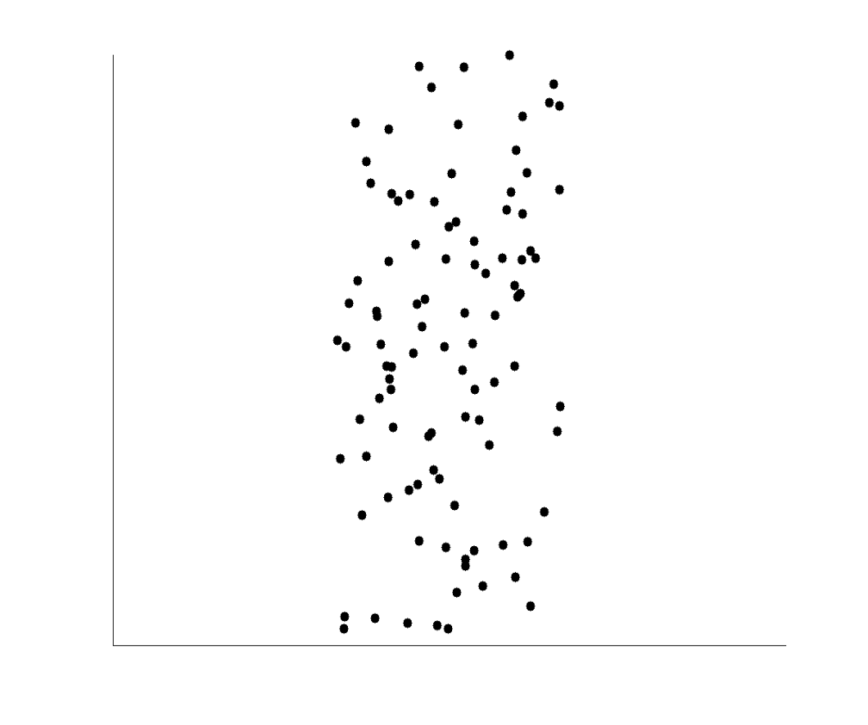
Uncorrelated Data
8

Slide 26
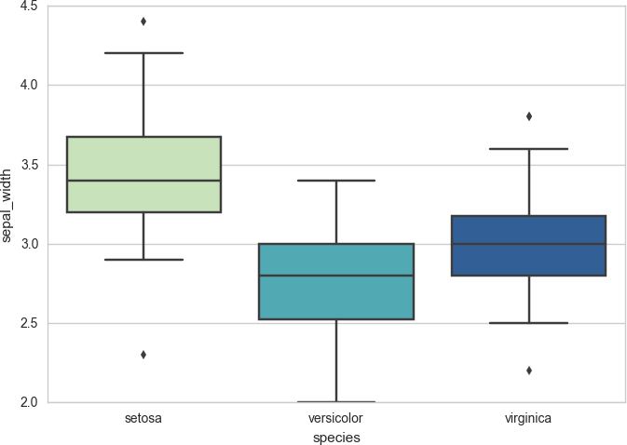
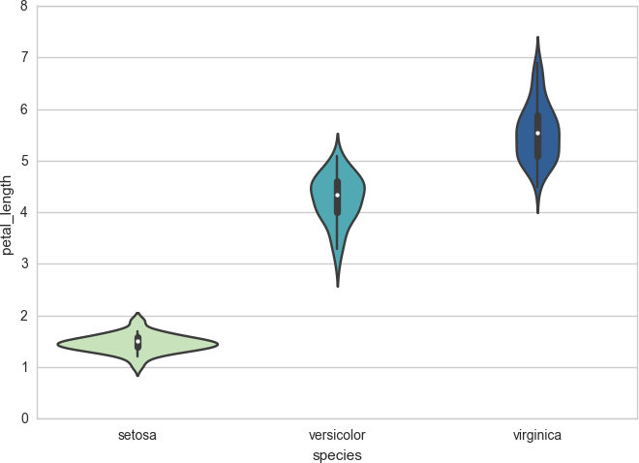
Data Visualization using Python
Box Plot
Violin Plot

Slide 27
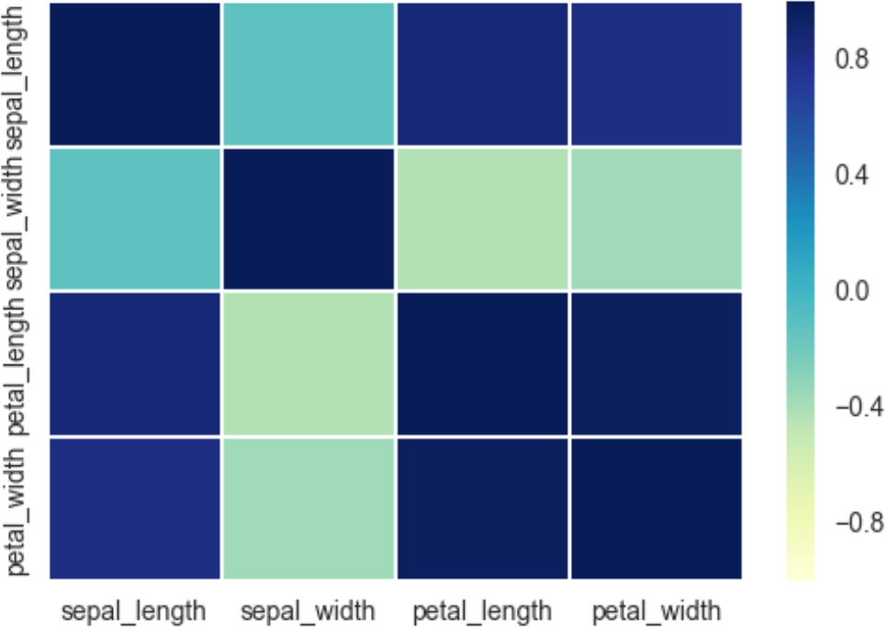
Data Visualization using Python
Heatmap for Correlation

Slide 28
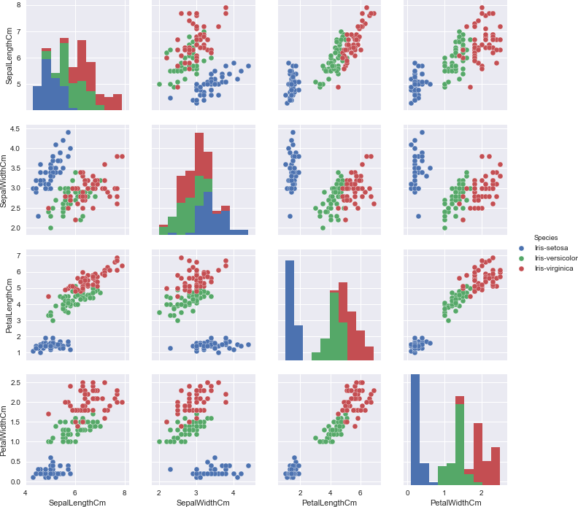
Data Visualization using Python
colour coding the groups
Pair Plot
Source: http://www.caesaryang.com/2017-06-01/Machine-Learning-with-the- Famous-Iris-Dataset.html

Slide 29
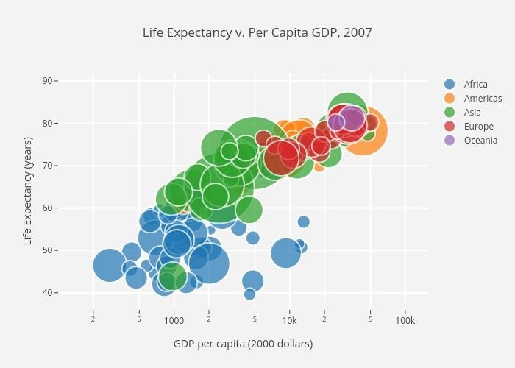
Data Visualization using Python
1st variable: GDP per capita 2nd variable: Life Expectancy 3rd variable: country size
Scatter plot with colour groupings and size encoding
Source: https://towardsdatascience.com/5-quick-and-easy-data-visualizations-in-python-with-code-a2284bae952f

Slide 30
Measuring Data Similarity and Dissimilarity
Similarity
Need to assess how alike or unalike objects are in comparison to one another - clustering, outlier analysis, nearest-neighbor
Numerical measure of how alike two data objects are
Value is higher when objects are more alike
Often falls in the range [0,1]
Dissimilarity (e.g., distance)
Numerical measure of how different two data objects are
Lower when objects are more alike
Minimum dissimilarity is often 0
Upper limit varies
Proximity refers to a similarity or dissimilarity

Slide 31
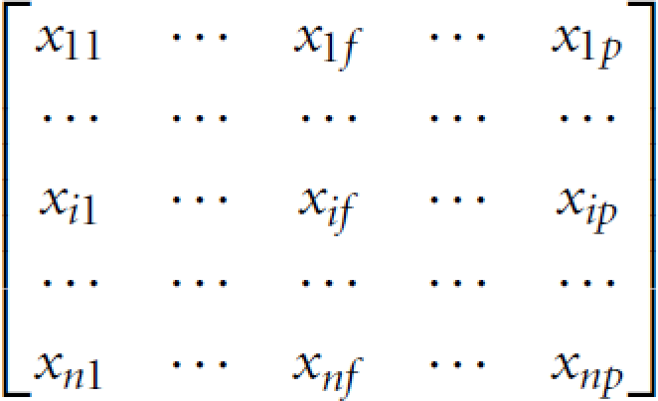
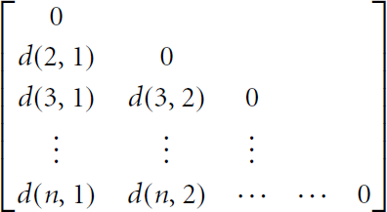
Data Matrix and Dissimilarity Matrix
Data matrix
n data points with p dimensions
n objects × p attributes
Dissimilarity matrix
Proximities for all pairs of n objects
n objects × n objects

Slide 32
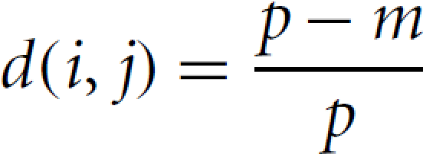
Proximity Measure for Nominal Attributes
Computing dissimilarity between objects described by nominal attributes
Method 1: Simple matching
– m: # of matches, p: total # of attributes
Method 2: Use a large number of binary attributes
– create a new binary attribute for each of the M nominal states

Slide 33
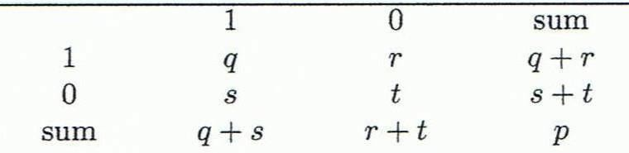
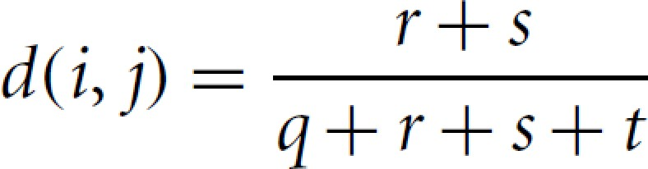

Proximity Measure for Binary Attributes
A contingency table for binary data
Distance measure for symmetric binary variables
Jaccard coefficient (similarity measure for asymmetric binary variables)
Object j
Object i
Jaccard coefficient is the same
as “coherence”

Slide 34
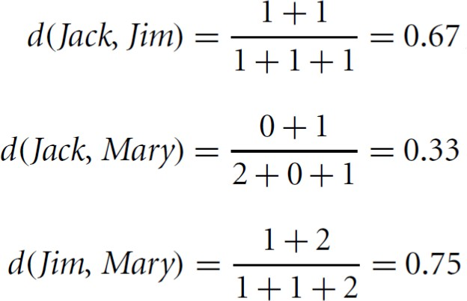

Dissimilarity between Binary Variables
Name | Gender | Fever | Cough | Test-1 | Test-2 | Test-3 | Test-4
Jack Mary Jim | M F M | Y Y Y | N N P | P P N | N N N | N P N | N N N
Gender is a symmetric attribute
Remaining attributes are asymmetric binary
Let the values Y and P be 1, and N be 0
Compute distance between the patients based only on the asymmetric attributes
Object j
Object i

Slide 35
Proximity Measure for Numeric Attributes
Minkowski distance: A popular distance measure
where i = (x_{i1}, x_{i2}, …, x_{ip}) and j = (x_{j1}, x_{j2}, …, x_{jp}) are two p‐ dimensional data objects, and h is the order (the distance so defined is also called L_{h} norm)
Properties
d(i, j) > 0 if i ≠ j, and d(i, i) = 0 (Positive definiteness)
d(i, j) = d(j, i) (Symmetry)
d(i, j) ≤ d(i, k) + d(k, j) (Triangle Inequality)
A distance that satisfies these properties is a metric

Slide 36
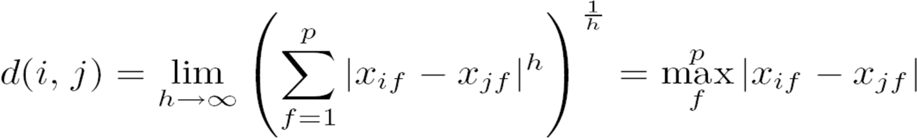
Special Cases of Minkowski Distance
h = 1: Manhattan (city block, L₁ norm) distance
– E.g., the Hamming distance: the number of bits that are different between two binary vectors
h = 2: (L₂ norm) Euclidean distance
h → ∞. “supremum” (L_{max} norm, L∞ norm) distance
– This is the maximum difference between any component (attribute) of the vectors

Slide 37









Example: Minkowski Distance
point | attribute 1 | attribute 2
x1 | 1 | 2
x2 | 3 | 5
x3 | 2 | 0
x4 | 4 | 5
Dissimilarity Matrices
Manhattan (L₁)
L | x1 | x2 | x3 | x4
x1 | 0
x2 | 5 | 0
x3 | 3 | 6 | 0
x4 | 6 | 1 | 7 | 0
Euclidean (L₂)
L2 | x1 | x2 | x3 | x4
x1 | 0
x2 | 3.61 | 0
x3 | 2.24 | 5.1 | 0
x4 | 4.24 | 1 | 5.39 | 0
Supremum
L∞ | x1 | x2 | x3 | x4
x1 | 0
x2 | 3 | 0
x3 | 2 | 5 | 0
x4 | 3 | 1 | 5 | 0

Slide 38
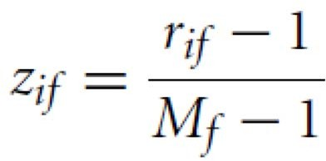
Proximity Measure for Ordinal Attributes
An ordinal variable can be discrete or continuous
Order is important, e.g., rank
Can be treated like interval‐scaled
– replace x_{if} by their rank
^{r}if
∈ {1,..., M _{f} }
– since each ordinal attribute can have a different number of states, map the range of each attribute onto [0, 1] by replacing i‐th object in the f‐th variable by
– compute the dissimilarity using methods for numeric attributes

Slide 39
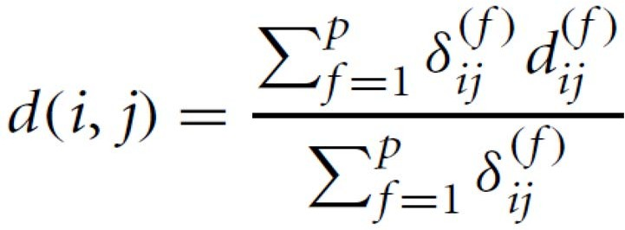

Dissimilarity for Attributes of Mixed Type
A database may contain all attribute types
– Nominal, symmetric binary, asymmetric binary, numeric, ordinal
One may use a weighted formula to combine their effects

Slide 40
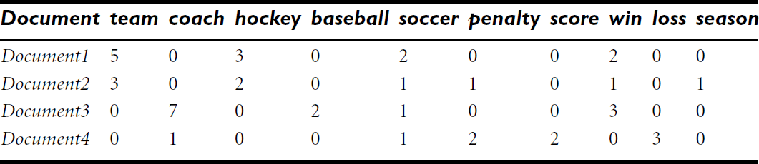
Cosine Similarity
Documents are represented by term‐frequency vector
– thousands of attributes/ keywords, each recording the frequency of a particular word in the document
Applications: information retrieval, biologic taxonomy, gene feature mapping, …
Term‐frequency vectors are typically very long and sparse
two term‐frequency vectors may have many 0 values in common
corresponding documents do not share many words
does not imply they are similar
need a measure that focuses on the words that are common in the two documents, and the occurrence frequency of such words
https://www.machinelearningplus.com/nlp/cosine‐similarity/

Slide 41
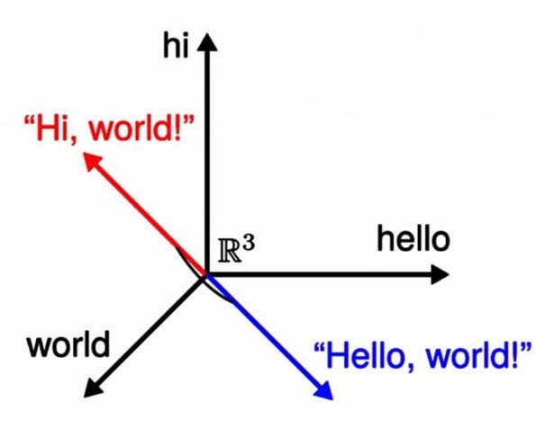
Cosine Similarity
Measures how similar two documents are irrespective of their size
– Determines whether two vectors are pointing in roughly the same direction
Cosine similarity ignores 0‐0 matches
Counting 0‐0 matches in sparse data would inflate similarity scores
Even if the two similar documents are far apart by the Euclidean distance because of the size (for example, the word “chatbot” could appear 50 times in one document and 10 times in another), they could still have a smaller angle between them
Smaller the angle, the higher the similarity.

Slide 42
Example: Cosine Similarity
Cosine similarity: If d₁ and d₂ are two term‐frequency vectors, then
cos(d₁, d₂) = (d₁ • d₂) /||d₁|| ||d₂||
where • indicates vector dot product, ||d||: the Euclidean norm
The measure computes the cosine of angle between vectors d₁ and d₂
Example: Find the similarity between documents d₁ and d₂ d₁ = (5, 0, 3, 0, 2, 0, 0, 2, 0, 0)
d₂ = (3, 0, 2, 0, 1, 1, 0, 1, 0, 1)
d₁•d₂ = 5×3 + 0×0 + 3×2 + 0×0 + 2×1 + 0×1 + 0×1 + 2×1 + 0×0 + 0×1 = 25
||d₁||= (5² + 0² + 3² + 0² + 2² + 0² + 0² + 2² + 0² + 0²)^{0.5} = (42)^{0.5} = 6.48
||d₂||= (3² + 0² + 2² + 0² + 1² + 1² + 0² + 1² + 0² + 1²)^{0.5} = (17)^{0.5} = 4.12
cos(d₁, d₂ ) = 0.94
Python example ‐ https://www.learndatasci.com/glossary/cosine‐similarity/

Slide 43
Summary
Data attribute types: nominal, binary, ordinal, interval‐scaled, ratio‐scaled
Many types of data sets, e.g., numerical, text, graph, Web, image
Gain insight into the data by:
Basic statistical data description: central tendency, dispersion, graphical displays
Data visualization: map data onto graphical primitives
Measure data similarity
Above steps are the beginning of data preprocessing

